Slide 1
Understanding Verbs:
Gerunds, Participles, and Infinitives

Slide 2
Verbals
A verbal is a noun or an adjective formed from a verb.
There are three kinds of verbals:
gerunds, participles, and infinitives.
Verbals express an action or state of being.
The difference between verbals and other nouns and adjectives is that verbals can take their own objects even though they are not verbs.

Slide 3
What exactly are the verbals?
A gerund is a verbal that ends in -ing and functions as a noun.
Writing a good essay takes effort.
An infinitive is a to + verb verbal that functions as a noun, adjective, or adverb.
To graduate from college takes time.
A participle is a verbal used as an adjective, and it often ends in -ing (present) or –ed (past).
Shaking with anger, Gloria turned away from her cheating boyfriend Carlos.
Shaken with fear, Ed walked away from the wrecked car.

Slide 4
Gerunds
A gerund is a verbal that ends in –ing and functions as a noun.
Since they are derived from verbs and have an –ing ending, they express action.
Gerunds can be used as a subject, direct object, subject complement, and object of preposition because it functions as a noun.
Gerunds may occur as one word or be part of a gerund phrase.

Slide 5
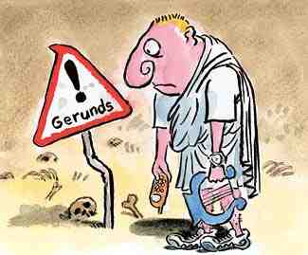
Gerunds as a Subject
Traveling might satisfy your desire for new experiences.
In this sentence we see that traveling is the subject of satisfy

Slide 6
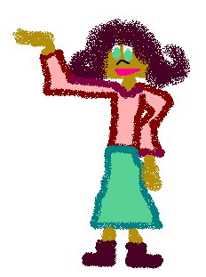
Gerund as a Direct Object
GERUNDS are super! Without them, verbs couldn’t be nouns!
They appreciate my singing.
Singing is used as a direct object because it answers the question of the verb (what are they appreciating? Singing)

Slide 7
Gerunds as a Subject Complement
My mom’s favorite activity is sailing.
Sailing is explaining the subject in this sentence (what activity? sailing.)

Slide 8
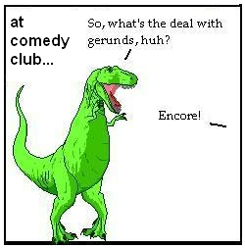
Gerunds as an Object of Preposition
The police arrested him for speeding.
Speeding is the object of for in this example because it is explaining the prepostion (for what? For speeding.)

Slide 9
Gerund Phrase
A gerund phrase consists of a gerund plus a modifier, object, and/or complement.
Finding a needle in a haystack would be easier than what we're trying to do.
Finding is the gerund in the italicized phrase.
Needle is the direct object, and in a haystack is the prepositional phrase within the gerund phrase.

Slide 10
QUIZ TIME! Aren’t you glad you were paying attention?!
Daniel started doing his homework at 12:30 PM.
He apologized for being late.
He insisted on speaking to the manager because there was a fly in his soup.
Bonus: She made plans for leaving home to go to Fiji.

Slide 11
Answers! Cross your fingers!
Doing
Being
Speaking
Leaving- object of preposition
Life would be empty without Gerunds

Slide 12
Participles
Participles are verbals that usually function as adjectives and occasionally function as adverbs.
Participles generally end with an –ed or –ing ending.
Since participles are derived from verbs, they express actions or states of being.

Slide 13
Participles
When participles function as adjectives, they are usually found preceding the nouns and pronouns in a sentence.
When participles function as adverbs, they are typically found following the verb in a sentence.

Slide 14
Participles
There are two types of participles: present participles and past participles.
Present participles have an –ing ending.
Past participles may have one of several past tense endings, including –ed, -en, and -d.
As with gerunds, participles may occur as one word, or they may be part of a participial phrase.

Slide 15
Present Participles
The running water provided a picturesque view. (adjectival)
The clown was able to stop the raging bull from attacking the rider. (adjectival)

Slide 16
Past participles
The crushed bug was an unpleasant sight. (adjectival)
He was able to repair the broken lock. (adjectival)

Slide 17
Present participial phrases
The car stopping at the light was hit by the truck. (adjectival)
The bull came running towards the rodeo clown. (adverbial)

Slide 18
Past participial phrases
James, amused by the crowd’s response, continued to perform magic tricks. (adjectival)
Shaken from his near-death experience, John was unable to speak. (adjectival)

Slide 19
Infinitives
An infinitive is the word “to” plus the base form of a verb.
I wanted to run out the door when the teacher announced a pop quiz.
I tried to think of an excuse, but my mind drew a blank and so I was forced to baby-sit for my bratty cousin.

Slide 20
To form infinitives use to + base form of the verb I want to dance To form negative infinitives use Not + infinitive He decided not to go to the party.

Slide 21
Infinitives
Infinitives may function as nouns, adjectives or adverbs.
Since infinitives are derived from verbs, they do express actions or states of being.

Slide 22
Infinitives
When infinitives function as adjectives and adverbs, they are usually found preceding nouns and pronouns in sentences,
When they function as nouns, they are used as subjects, direct objects and objects of prepositions.

Slide 23
It is not a preposition
Infinitives (to + verb) should not be confused with prepositional phrases (to + noun or pronoun).
I went to the store with my two year old brother, Jake.
The above examples are not infinitives. “To the store” is a prepositional phrase.

Slide 24
Examples
Infinitives functioning as nouns
To love is the greatest achievement.
Infinitives functioning as adjectives
Jason’s group was the last to arrive.
Infinitives functioning as adverbs
The students must pass the GRE exams to graduate.

Slide 25
Infinitive Phrases
An infinitive phrase is a group of words that includes an infinitive and any other words to complete its meaning.
Ex) To fly a plane was her goal.
To fly is the infinitive (to + verb)
To fly a plane is the infinitive phrase.

Slide 26
Some verbs although they can be used after both gerunds and infinitives have a difference in meaning. remember forget regret stop try get

Slide 27
She stopped smoking. She stopped to smoke. They forgot buying bread. They forgot to buy bread.

