Slide 1
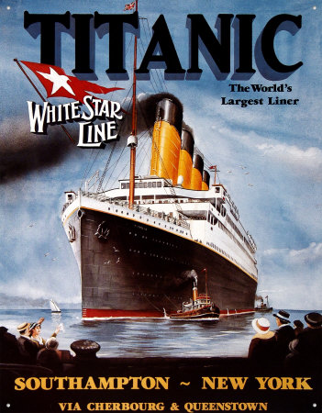
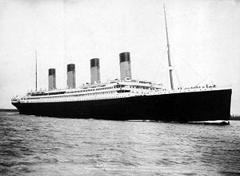
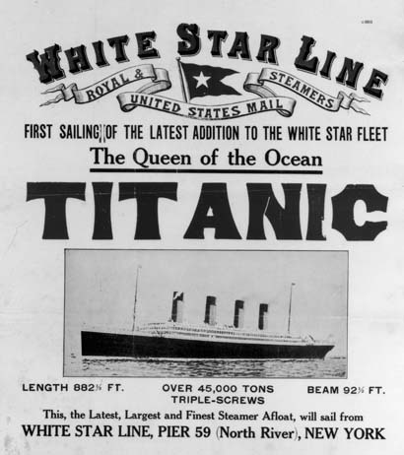
TITANIC
Learning Objectives:
To explore postcards from the Titanic.
To write from different viewpoints.
To write appropriately within the social historical context of 1912.

Slide 2
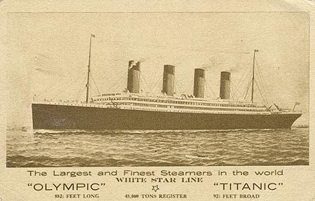
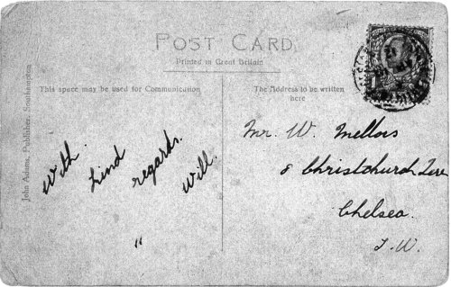
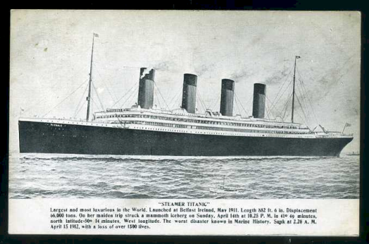
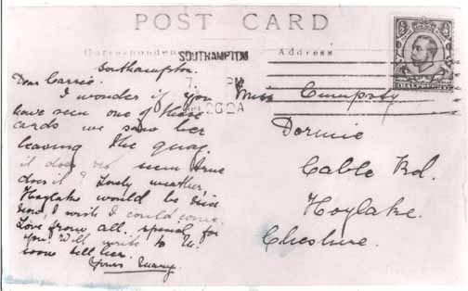
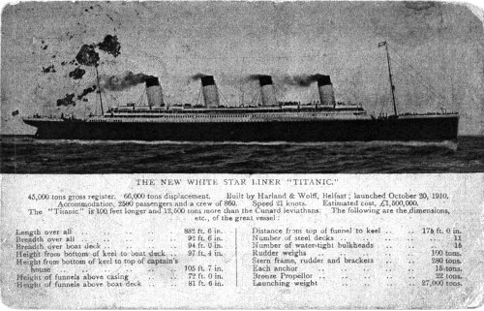
Postcards
The White Star Line produced a range of postcards to promote their latest and greatest ship.
Have a look at some of the original postcards.

Slide 4
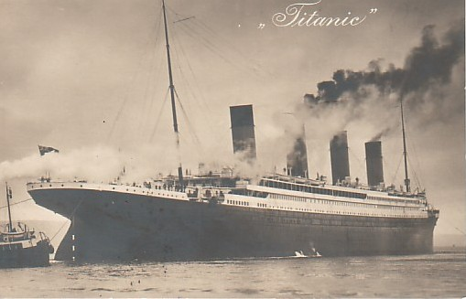

Slide 5
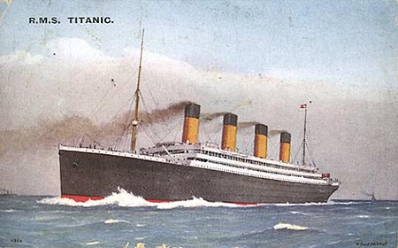

Slide 7
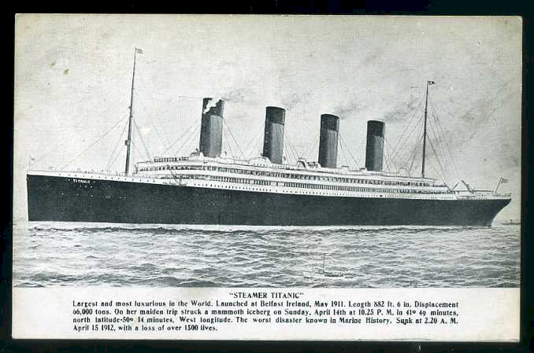

Slide 8
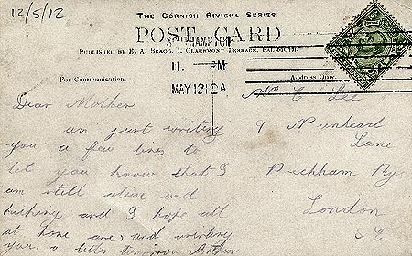

Slide 10
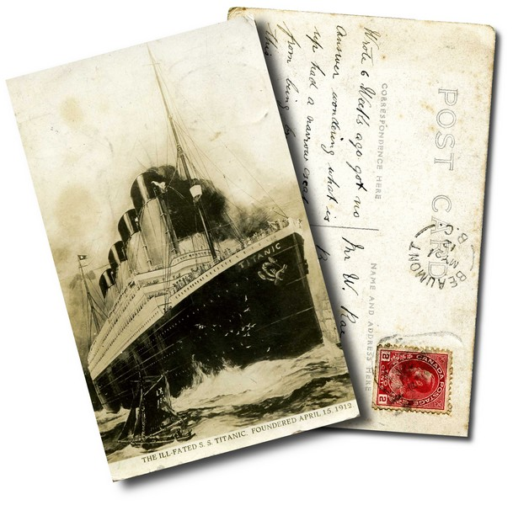

Slide 12
Postcards
Passengers boarded the Titanic up to three days before it set sail – it took a long time to board everyone and all of their belongings.
They used this time to acquaint themselves with the ship’s facilities.
When they set sail passengers were excited to be sailing on this new ‘unsinkable’ ship. Like many people on holiday they sent postcards to their families to share their experiences with them.
Titanic stopped at Cherbourg (France) and Queenstown (Ireland). This was an opportunity for postcards to go ashore and be sent.

Slide 13
Passenger Viewpoints
First Class
Imagine how the first class passengers would be feeling.
Think about the range of facilities they would have had.
Look back to our introduction to the Titanic to remind yourself of the amenities available to first class passengers.
Mindmap how first class passengers would be feeling and what they would experience. Think about it within the social historical context of 1912.
How might an elderly lady experience the ship compared to a gentleman or a young child?

Slide 14
Passenger Viewpoints
Third Class
Imagine how the third class passengers would be feeling.
Many of the third class passengers on the boat were travelling to New York to start a new life. America was seen as a land of opportunity and many people wanted to move there for what they hoped would be a better quality of life.
How would these passengers be feeling? How would their experience be different to those passengers in first class?
Think about the facilities available to these passengers. Would they be impressed? How would they feel about only being allowed in certain areas of the ship? How did the ship’s crew treat them?
Mindmap how third class passengers would be feeling and what they would experience. Think about it within the social historical context of 1912.

Slide 15
Post Card Task
Write a postcard as if you are a passenger in first class.
You must design the postcard from scratch – think about the images and font style on the front of the postcards we have looked at and use them for inspiration.
Try and create a postcard that is as realistic as possible for 1912 – both front and back.
You will be writing from a passenger’s viewpoint – explore what they have done, what they think of the ship and how they are feeling in your postcard.
You can choose what your imaginary passenger is like, think about their age, gender, personality etc.
You must write from their viewpoint. PLAN FIRST!
REMEMBER: Postcards are written in an informal tone and in the first person.

