Slide 1

POETRY
HOW TO UNDERSTAND ONOMATOPOEIA.

Slide 2
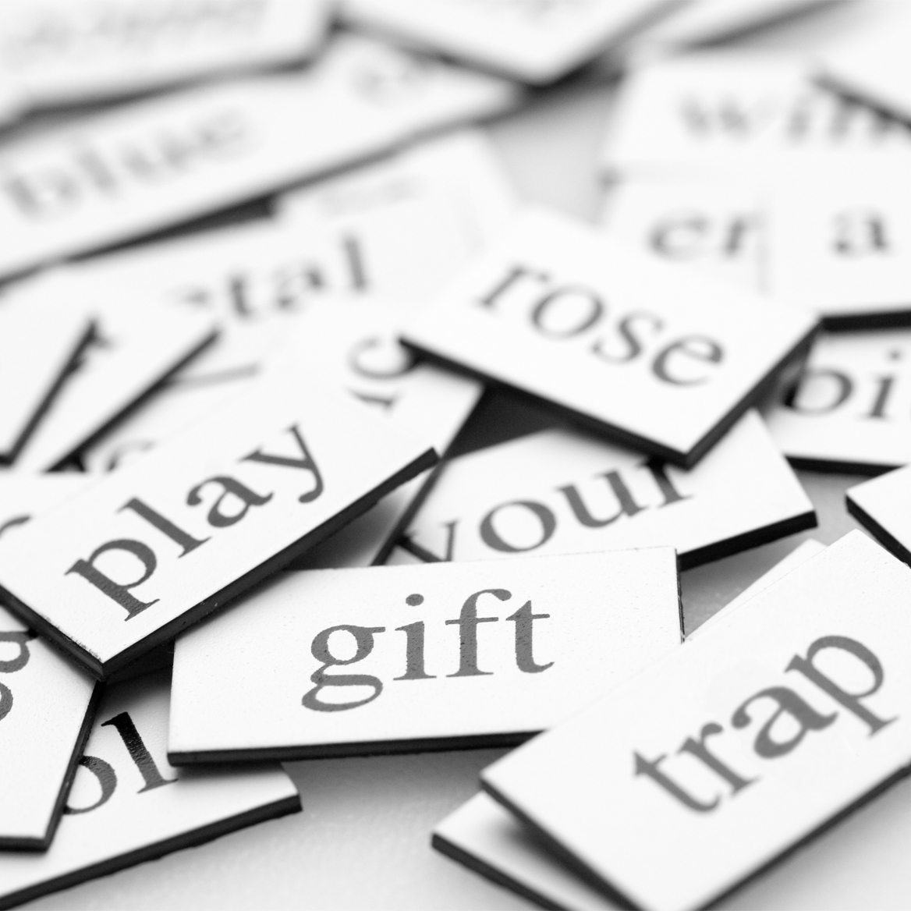
WORDSEARCH
Complete the word search
Then try to define the poetry terms
Need a dictionary?... Go get one!

Slide 3

POETRY TERMS
What do you know already?
What about onomatopoeia?
An onomatopoeia is a word which sounds like the thing it is describing.
E.g The leaves crunched under my footsteps.
E.g Fireworks bang very loudly

Slide 4
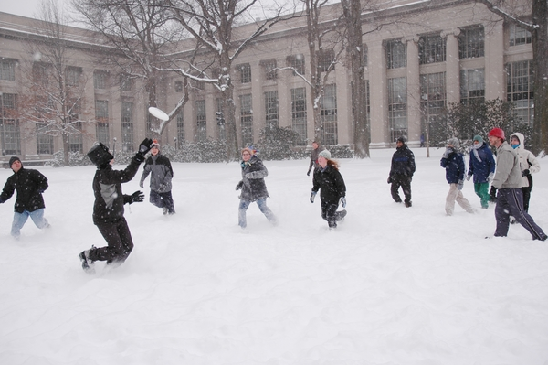
WHAT ONOMATOPOEIA’S CAN YOU EXPECT TO HEAR IN THIS PICTURE?
Crunch – footsteps on snow
Snap – tree branches snapping
Whoosh – wind blowing
Bang – snowballs hitting the building
Yowl – People being hit by snowballs
Whisper – of the wind

Slide 5

WHAT ONOMATOPOEIA’S CAN YOU HEAR IN THIS PICTURE?
Crunch of leaves
Whisting wind
Snap of the branches
Crash of the branches falling to the floor
Whoosh
Chatter of the people
Crackle of the fires in peoples houses to keep them warm

Slide 6
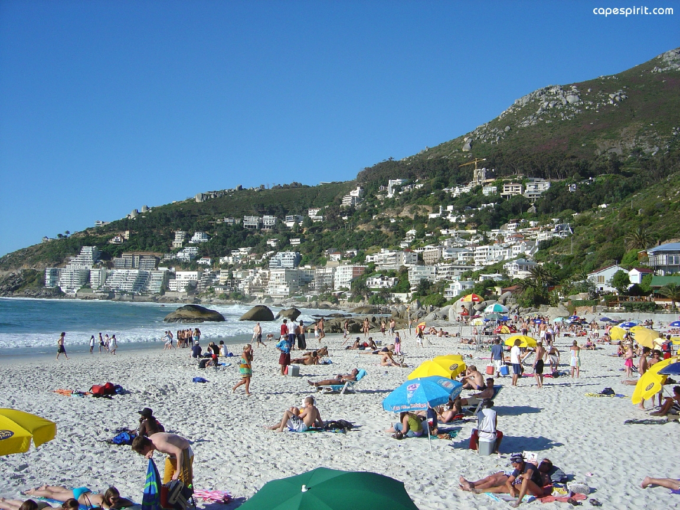
WHAT ONOMATOPOEIA’S CAN YOU HEAR IN THIS PICTURE?
Splash of the sea/waves
Chatter of the people
Squeal of the people
Click of photos being taken
Buzz of the flies
Tweet of the sea gulls

Slide 7
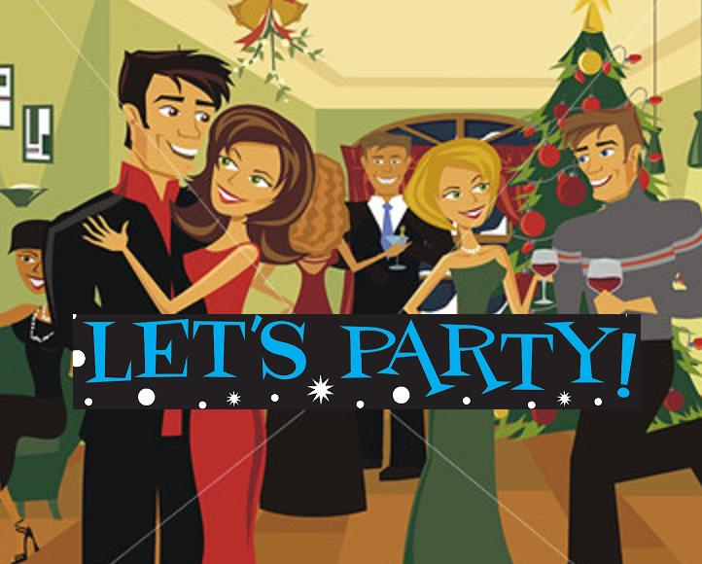
WHAT ONOMATOPOEIA’S WOULD YOU RELATE TO THIS PICTURE?
Chatter of the people
Smash – glasses falling over
Click – photos being taken
Bang – fireworks outside
Squeak – the chairs
Tick tock – sound of a clock in the room
Ding dong – doorbell
Whoosh – wine bottle top flying across the room

Slide 8
CAN YOU THINK OF ANY MORE ONOMATOPOEIA’S?
Bang
Crash
Mutter
Grumble
Thunder
Beep
Buzz
Crackle
Flick
Murmur
Hiss
Cackle
Giggle
Honk
Pop
Quack
Sizzle
Smack
Shush
Snip
Thud
Thump

