Slide 1
Learning Objectives: - to understand the differences between a tabloid and broadsheet newspaper. - to understand the history of newspaper reporting in Britain. - to complete a scientific investigation into the language and presentation of tabloids and broadsheets. - to collect and use data which you will analyse and evaluate effectively.
Journalism Project
Notes:
These L.O.s are for this part of the journalism project only.

Slide 2
Journalism
In your books draw a spider diagram that includes everything you know about journalism.
What is it?
What different forms of journalism are there?
Notes:
As a class use IWB to start and share ideas on this slide. Draw out range of styles etc.

Slide 3
Journalism is the practice of investigation and reporting of events, issues, and trends to a broad audience.

Slide 4
Why study newspapers?
Newspapers are still going strong, 300 years after the first one was produced.
30 million are sold in Britain every day.
In a recent survey of 16-34 year olds, it was discovered that newspapers were thought to be ‘informative’, ‘serious’ and ‘influential’, more so than radio or television.
42% agreed that ‘newspapers are an important part of daily life’.
Notes:
Ask students what they think about newspapers.

Slide 5
Newspapers
There are hundreds of different newspapers hitting the streets every day in the UK
How many can you name? Mind map as many as you can in the next two minutes.
Notes:
Go through pictures after students have completed this activity.

Slide 6
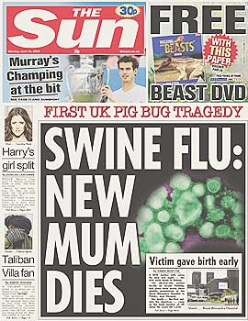

Slide 7
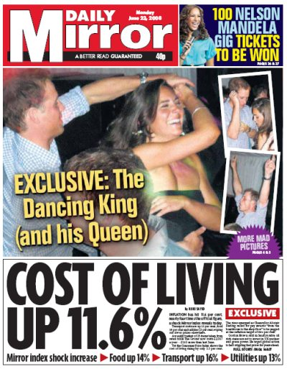

Slide 10
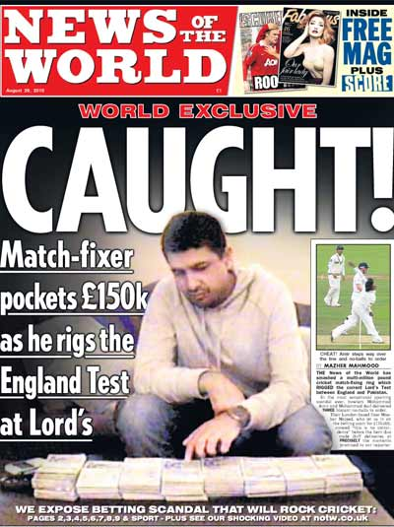

Slide 11
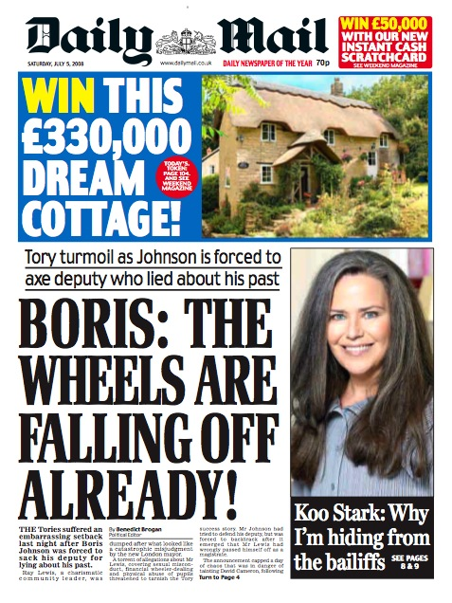

Slide 13
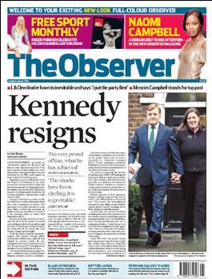

Slide 14
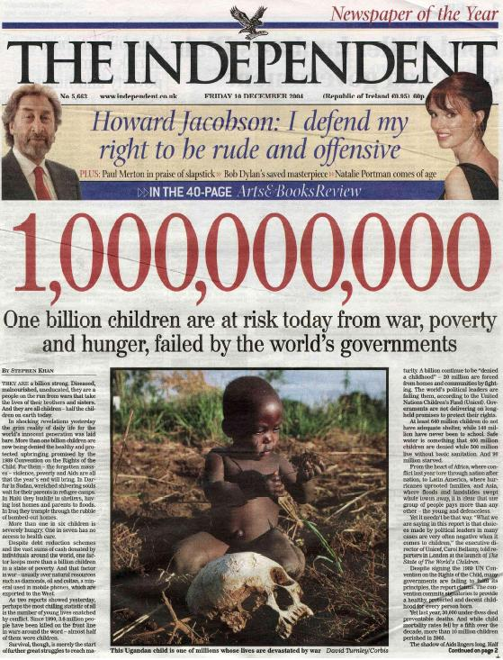

Slide 15
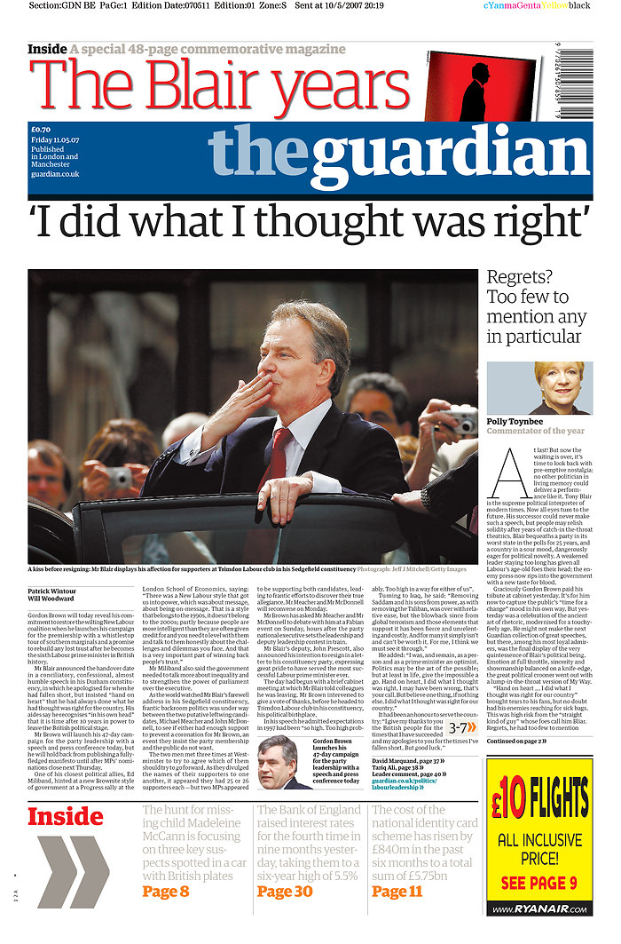

Slide 16
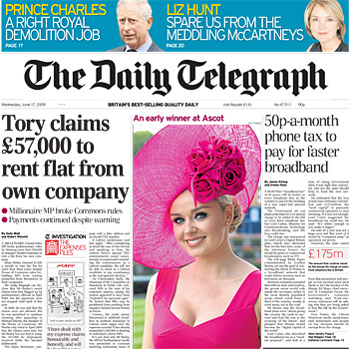

Slide 17
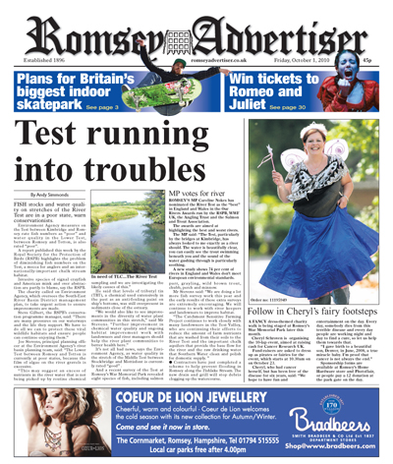

Slide 18
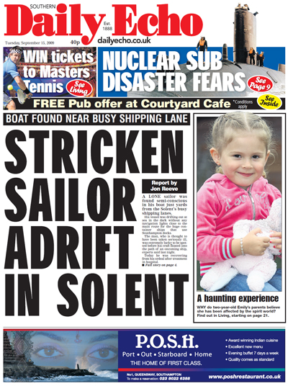

Slide 19
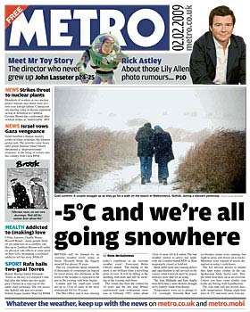

Slide 21
Broadsheets
Broadsheets – newspapers printed in a large format (pages 37cm x 58cm) Traditionally more serious in content than tabloids. (The Times, The Daily Telegraph, The Independent)
Notes:
Slides 21-26
Basic definitions. Students could create a poster exploring the differences/design a front page of a new tabloid/broadsheet and label the features.
Higher ability students should research history of newspapers in more detail. Wikipedia has more info on the history of different newspapers with lots of statistics etc.

Slide 22
Tabloids
Tabloids – newspapers with pages half as large as broadsheets, usually more highly illustrated and traditionally less serious. (The Sun, The Mirror, Daily Mail, Daily Express)

Slide 23
What are the main features of a TABLOID?
The Sun, The Mirror and The Daily Star are all called REDTOPS
This is because they have red MASTHEADS
A masthead is the title of the newspaper which appears in the large type at the top of the front page.
N.B. The Sun was established in 1969 and is Britain’s most popular newspaper.

Slide 24
What are the stories about?
They include international news and politics but generally include more gossip .
The stories are written simply and are quite short.
They tend to have more pictures than other newspapers.
The Sun has a reading age of 9!

Slide 25
What are the main features of a broadsheet?
They have a much higher news content.
They usually cost more and have lower circulation figures than the Tabloids (Why?)
The Times is the oldest, founded in 1788
The Daily Telegraph sells the most and as a result charges high prices to its advertisers (so why do they pay it?)
The Independent is the newest, founded in 1986. It generally has more colour photos than the others.
The Financial Times is the only national to be printed on pink paper. It deals with mainly business and economic news, although it does have other news, including a sports section.

Slide 26
The Daily Mail and The Daily Express are also Tabloids but are referred to as ‘Middle Market Dailies’.
Their readership is somewhere in between the tabloids and the broadsheets.
There is plenty of news and features for people but less gossip; they are considered to be a bit more serious than the tabloids.

Slide 27
A Scientific Investigation
Title: Investigation into the differences between tabloid and broadsheet newspapers.
Introduction: Background information on newspapers. Why are they important? What is the history of newspapers? Why are there different styles of newspapers?
Prediction: What do you expect to happen? Think about word choices, sentence types, pictures, type of stories, picture/text ratio, etc.
N.B. Use what you have learnt so far this lesson to complete this part of the investigation report.
Notes:
It is very important you follow this exact format and make it clear to students that this is the same skill they need in Science to get higher levels.
Lower ability students have a writing frame. Higher ability students should write this themselves. Could be done in groups/pairs or individually depending on the ability of the class.
Introduction for higher ability students should include some of their research.

Slide 28
Deciding on the data
The next step is to decide what data is needed and where it can be collected from.
Data can be collected from a primary source or a secondary source.
Data from a primary source is data that you have collected yourself, for example:
From a survey or questionnaire of a sample of people.
From an experiment involving observation, counting or measuring.
Data from a secondary source is data that you have collected from somewhere else including the Internet, reference books or newspapers.
Notes:
Discuss possible sources of secondary data. – ONLY FOR HIGHER ABILITY STUDENTS.
This is a Maths cross curricular link.

Slide 29
Resources and materials: What resources and materials will you need to complete your investigation? Make a list.
Variables: What are the variables in your investigation?
Independent - what are you changing?
Controlled - what are you keeping the same?
Dependent – what are you measuring?
Method: What are you going to do?
N.B. Use imperative language to write your method (bossy verbs at the start of your sentences - like a recipe!)
Notes:
Independent variable is the newspaper (e.g. The sun, the times etc.)
Controlled variable is the same story in all papers, same group of students counting/recording evidence etc.
Dependent is word length and sentence length.
Method must be written like a recipe. Students must not use “I/We are going to” and instead say “Decide on...” “Underline...”

Slide 30
Designing a data collection sheet
A data collection sheet can be used to record data that comes from counting, observing or measuring.
It can also be used to record responses to specific questions.
For example, to investigate a claim that the amount of TV watched has an impact on weight we can use the following:
age
sex
height (cm)
weight (kg)
hours of TV watched per week
Notes:
Skip over this if it over complicates if for weaker students.

Slide 31
Using a tally chart
When collecting data that involves counting something we often use a tally chart.
For example, this tally chart can be used to record peoples’ favourite snacks.
favourite snack
tally
frequency
crisps
13
fruit
6
nuts
3
sweets
8
The tally marks are recorded, as responses are collected,
and the frequencies are then filled in.
Notes:
Skip over this if it over complicates if for weaker students.

Slide 32
Results: What are your findings? You can present these in a table/graph/pie chart etc.
Organising your Data
Once data has been collected it is often organised into a frequency table.
For example, this frequency table shows the favourite take-away meals of a group of pupils:
Notes:
Students could present this information on a bar graph, pie chart or table. Higher ability students should have a table and one form of chart/graph as a minimum.

Slide 33
Continuous data comes from measuring and can take any value within a given range.
Continuous data is usually grouped into equal class intervals.
 | The Sun | The Times | The Express | The Daily Mail
2 ≥ letters < 4
4 ≥ letters < 6
6 ≥ letters < 8
8 ≥ letters <10
10 ≥
Notes:
≥ means equal to or more than
< means less than
Higher ability students should look at a range of newspapers and stories. Lower ability students should focus on one story which has been pre selected and put into an easy read format.

Slide 34
Analysis: What do your results show you?
Evaluation: Look back to your introduction and prediction. Have you proved or disproved your theory with your results? Is there anything that stands out as unusual or significant?
Notes:
Focus on this area – model writing analysis and evaluation. This is the bit Science students struggle with the most so really focus on it.
Analysis is what your results show.
Evaluation is looking at whether your prediction was accurate or not and exploring why. It is also an opportunity to discuss any oddities, e.g. A broadsheet having more pictures would be unexpected – why is it the case? Is it usual?

Slide 35
Step One – choose two articles from different newspapers. Underline every third word (skip over proper nouns)
US hostages shot dead by pirates
Four American hostages have been shot dead by pirates on a yacht seized in the Arabian sea, according to the US military.
The US military's Central Command said the dead hostages were only discovered after American forces responded to gunfire and boarded the pirated yacht, known as the Quest.
Pirates kill US yacht hostages
FOUR Americans captured by pirates sailing in the Indian Ocean have been shot dead.
Phyllis Macay, 59, and her partner Robert Riggle, 67, were sailing with the yacht's owners Jean and Scott Adam off the coast of Somalia when they were held by pirates on Friday.
Notes:
Example of the step by step process – do this as a class first. Get students to count the letters in each word and practise tallying the data.

Slide 36
Step Two - collecting the data
 | The Sun | The Times
2 ≥ letters < 4 | IIIIII 46% | II 12%
4 ≥ letters < 6 | IIIII 38% | IIIII 29%
6 ≥ letters < 8 | I 8% | IIII 24%
8 ≥ letters <10 | I 8% | IIIII 29%
10 ≥ | 0% | I 6%
Count the length of each word and tally on the chart.
Work out the percentage using the simple formula below:
# in tally X 100
/by # in sample
E.g. The Sun has 6 words in the ‘2 ≥ letters < 4’ box out of a total of 13 words counted, so the sum would be:
6 x 100
/13 = 46.15%
Rounded to nearest whole number = 46%
Notes:
These are the results from the newspaper articles on the previous slide.

Slide 37
Things you could investigate ...
Number of words in a paragraph.
Number of words in a sentence.
Ratio of pictures to words.
Number of ‘serious’ news articles versus ‘celebrity/gossip’ articles.
Notes:
Differentiate through length of articles, number of newspapers and the number of things students investigate. Students can do this in pairs or in groups.

Slide 38
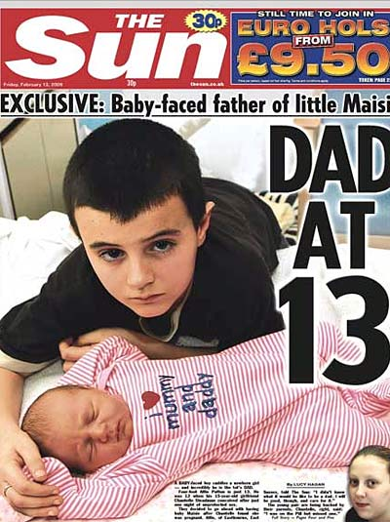
A
B
C
D
Headline:
Logo/Adverts:
Article:
Pictures:
1
2
3
4
5
Notes:
N.B. This for high ability students – draw a grid on a front page/any page and work out the distribution of images etc. on the front page.

