Slide 1
AFOREST persuasive
techniques
To learn and understand the use of persuasive techniques.

Slide 2
This lesson we will:
Mind-map where we might find persuasive techniques.
Read about some persuasive techniques.
Complete a matching activity.

Slide 3
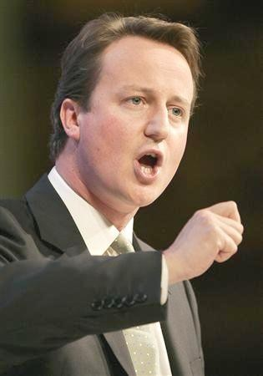
Where might we find persuasive techniques?

Slide 4
A.F.O.R.E.S.T.
Alliteration
Facts
Opinion
Repetition
Emotive language
Statistics
Three (rule of)

Slide 5
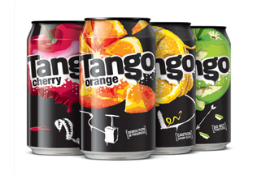
Alliteration
This is when more than one word in a row starts with the same letter:
‘Tango will make your tastebuds tingle’

Slide 6
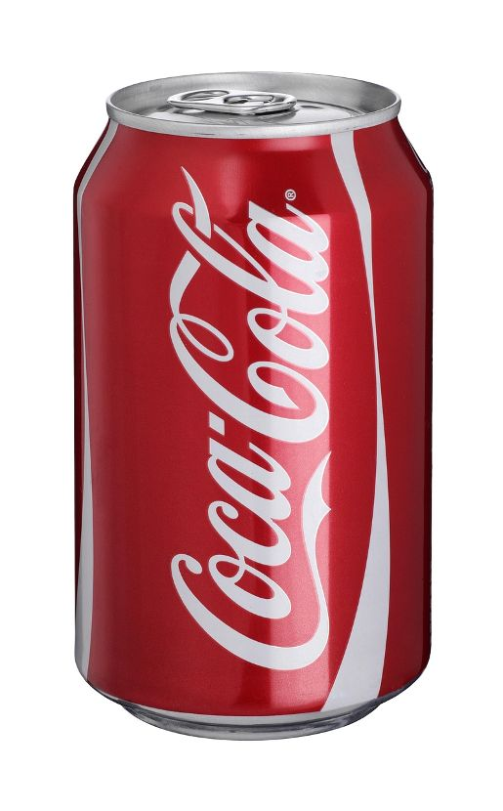
Facts/Opinion
Coca-cola is the most popular soft drink in the world.
Coca-cola is the most delicious soft drink there is.

Slide 7
Repetition
Repeating a word or phrase
http://www.youtube.com/watch?v=F_-9QFvhQWo

Slide 8
Emotive language
Language that appeals to your emotions/ your heart.
http://www.youtube.com/watch?v=zHzMLGH1Rfs

Slide 9
Statistics
Usually these are stated as numbers or percentages.

Slide 10
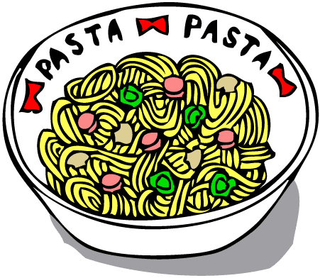
Three (rule of)
Using three descriptive word, or repetition x3 e.g.
‘Disneyland is the most exciting, wonderful, unbelievable theme park.’
‘Delicious pizza, delicious pasta, delicious everything!’

Slide 11
A.F.O.R.E.S.T.
Alliteration
Facts
Opinion
Repetition
Emotive language
Statistics
Three (rule of)

Slide 12
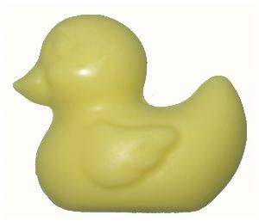
Sunshine soap
Sunshine soap is the most beautiful smelling soap in the entire world. 100% of people who have washed with sunshine soap said they would buy it again. You will be squeaky fresh and squeaky clean in no time with sunshine soap!

